Slide 1
Module 2: Lesson 1:
Choose the best Azure IoT Service for your application

Slide 2



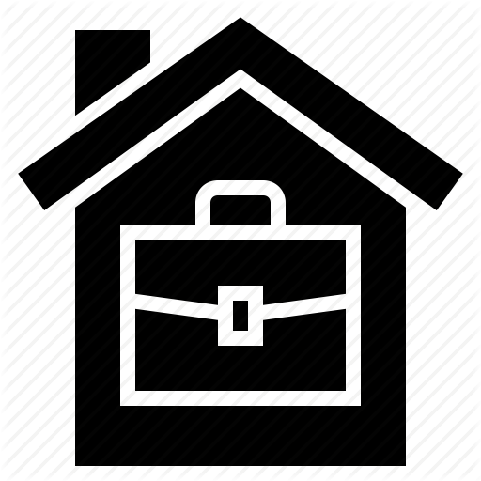

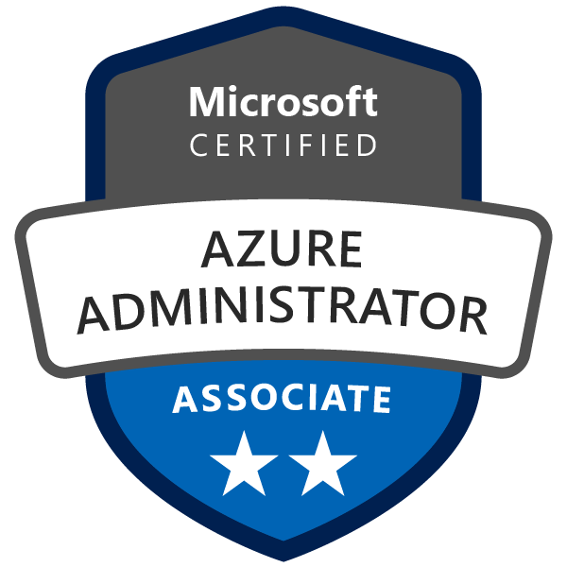
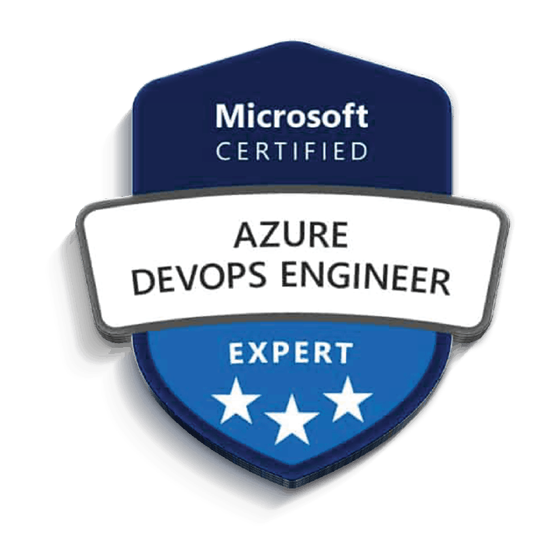
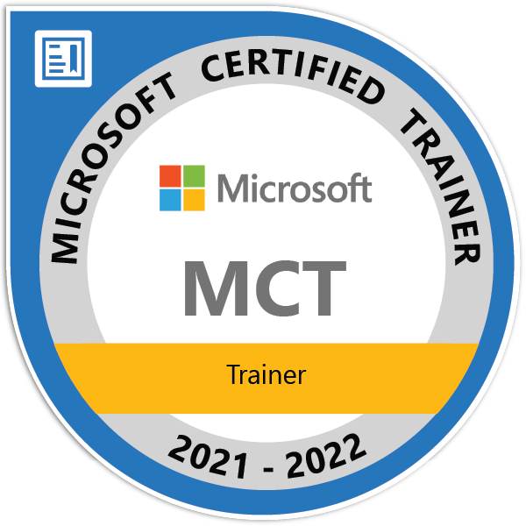
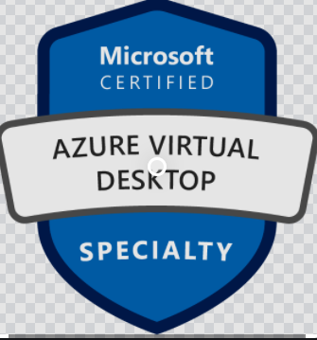
About The Presenter
Olutayo Adaraloye
Platform Engineer at Link Group
Microsoft Certified Trainer
Microsoft Technologies Expert (Azure Administrator, Azure DevOps, Azure Solutions Architect, AVD Specialty)
Certified ITIL Foundation
LinkedIn

Slide 3


Lesson 1: Overview
This lesson will cover
What is IoT
IoT devices
Application of IoT
Choosing the right IoT service
Analyse the decision criteria
Case Study
Knowledge Check

Slide 4
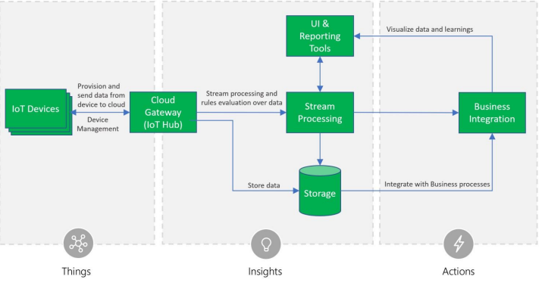
IoT (Internet of Things)
What is IoT
IOT (Internet Of Things) is a network of connected devices that send data to, and receive instruction from a centralize computer system This information is transmitted via the internet.

Slide 5
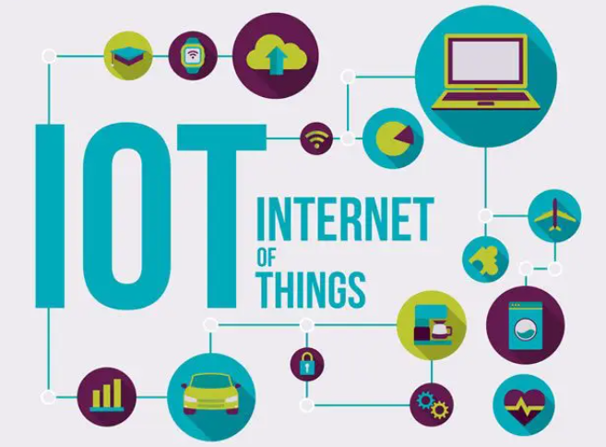
IoT Devices
IOT devices collect data from embedded sensors, sensors capable of measuring things like temperature, height count, light, sound motion, flow etc.
IOT sends it sensor readings through messages over the internet to an endpoint a centralized server that ingest, processes and store messages, the data ca be used to monitor the sense of usage or can be used predict when the device need maintenance.
IOT receive new instruction or get a firmware update that modifies how the device functions, it also fix faulty issues that can reduce the device life span.

Slide 6

Application of IoT
The application of this technology span many industries such as Agriculture, commercial or residential.
Farmers can use IoT devices to monitor rainfall, wind soil and other conditions.
To understand when crop need fertilization. During harvest, farmers may use IoT sensors to analyze quantity and quality of the crop.
To improve future prediction for fertilization

Slide 7
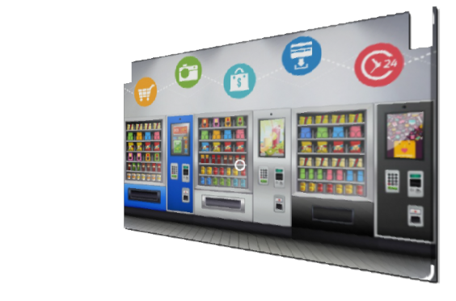
Application of IoT
Vending machines can send inventory information along with refrigerator performance data back to the centralize server to ensure the machine is operating properly and properly stocked.
Manufacturers can use IOT sensors to automate processes determine when the machine will need maintenance or detect error of the part are unsafe for workers,

Slide 8
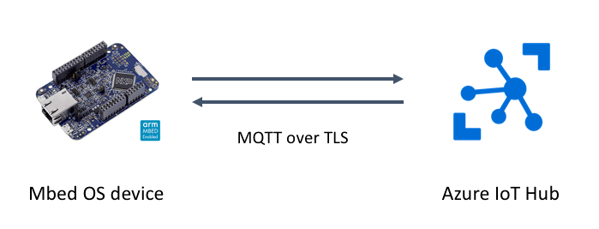
Choosing the right IoT Service for you
Azure IOT Hub:
It is a managed service hosted in the cloud, that act as a central message hub for bi-directional communication between your IOT application and the devices it manages. You can connect any device to your IOT Hub, if you primarily want to send message with your IOT devices and don’t need further reporting feature, use IOT hub.
Azure IOT Central built on top of IOT hub by adding a prebuilt customizable dashboard from which to view, connect to , and control your devices. You can observe the overall performance across all devices in aggregate and you can set up alert that send notification to specific devices that needs maintenance.
Notes:
Azure IoT Hub is a managed service that's hosted in the cloud and that acts as a central message hub for bi-directional communication between your IoT application and the devices it manages. You can use Azure IoT Hub to build IoT solutions with reliable and secure communications between millions of IoT devices and a cloud-hosted solution back end. You can connect virtually any device to your IoT hub.
The IoT Hub service supports communications both from the device to the cloud and from the cloud to the device. It also supports multiple messaging patterns, such as device-to-cloud telemetry, file upload from devices, and request-reply methods to control your devices from the cloud. After an IoT hub receives messages from a device, it can route that message to other Azure services.
From a cloud-to-device perspective, IoT Hub allows for command and control. That is, you can have either manual or automated remote control of connected devices, so you can instruct the device to open valves, set target temperatures, restart stuck devices, and so on.
IoT Hub monitoring helps you maintain the health of your solution by tracking events such as device creation, device failures, and device connections. Mbed is a platform and operating system for internet-connected devices based on 32-bit ARM Cortex-M microcontrollers. Such devices are also known as Internet of Things devices.

Slide 9
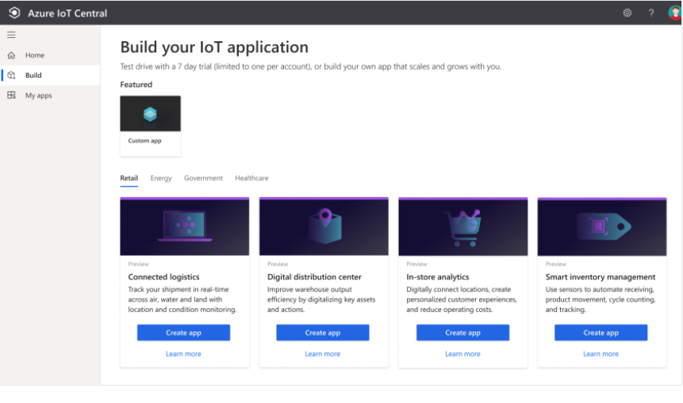
Choosing the right IoT Service for you
Azure IoT Central:
It provides starter template for different industries scenarios that you can use to get up and running quickly. If you need a comprehensive dashboard to control, monitor and report on your IoT devices, Azure IoT central will be your best choice.
Notes:
Azure IoT Central builds on top of IoT Hub by adding a dashboard that allows you to connect, monitor, and manage your IoT devices. The visual user interface (UI) makes it easy to quickly connect new devices and watch as they begin sending telemetry or error messages. You can watch the overall performance across all devices in aggregate, and you can set up alerts that send notifications when a specific device needs maintenance. Finally, you can push firmware updates to the device.
To help you get up and running quickly, IoT Central provides starter templates for common scenarios across various industries, such as retail, energy, healthcare, and government. You then customize the design starter templates directly in the UI by choosing from existing themes or creating your own custom theme, setting the logo, and so on. With IoT Central, you can tailor the starter templates for the specific data that's sent from your devices, the reports you want to see, and the alerts you want to send. Scenario: From your Mobile phone, search for iot plug and play on play store or App store Install this app go to this link below and follow the process https://docs.microsoft.com/en-us/azure/iot-central/core/quick-deploy-iot-central

Slide 10
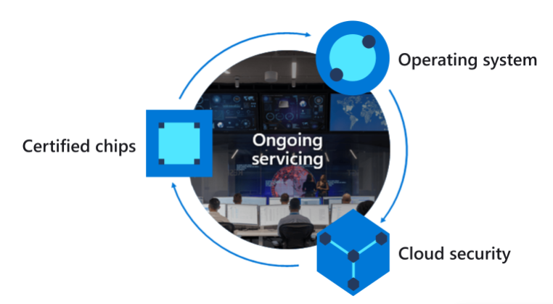
Choosing the right IoT Service for you
Azure Sphere creates an end to end highly secure IoT solution that encompasses everything from the hardware and operating system on the device to the secure method of sending message from the device to the message hub. Azure Sphere has built- in communication and security features for your internet connected devices. When security is a critical consideration, you want to choose Azure Sphere.
Notes:
Azure Sphere
Azure Sphere creates an end-to-end, highly secure IoT solution for customers that encompasses everything from the hardware and operating system on the device to the secure method of sending messages from the device to the message hub. Azure Sphere has built-in communication and security features for internet-connected devices.
Azure Sphere comes in three parts:
The first part is the Azure Sphere micro-controller unit (MCU), which is responsible for processing the operating system and signals from attached sensors. The following image displays the Seeed Azure Sphere MT3620 Development Kit MCU, one of several different starter kits that are available for prototyping and developing Azure Sphere applications.

Slide 11
Analyse the decision criteria
Is it critical to ensure that the device is not compromised?
Do I need a dashboard for reporting and management?
Notes:
Not in every case. Manufacturers and customers would rather not have their devices to be maliciously compromised and used for nefarious purposes, however in some cases it's more critical to ensure the integrity than others. An example would be that of an ATM in comparison to a washing machine. When security is a critical consideration in your product's design, the best product option is Azure Sphere, which provides a comprehensive end-to-end solution for IoT devices.
As we mentioned in the previous unit, Azure Sphere ensures a secure channel of communication between the device and Azure by controlling everything from the hardware to the operating system and the authentication process. This ensures that the integrity of the device is uncompromised. After a secure channel is established, messages can be received from the device securely, and messages or software updates can be sent to the device remotely.
Your next decision will be the level of services you require from your IoT solution. If you merely want to connect to your remote devices to receive telemetry and occasionally push updates, and you don't need any reporting capabilities, you might prefer to implement Azure IoT Hub by itself. Your programmers can still create a customized set of management tools and reports by using the IoT Hub RESTful API.
However, if you want a pre-built customizable user interface with which you can view and control your devices remotely, you might prefer to start with IoT Central. With this solution, you can control a single device or all devices at once, and you can set up alerts for certain conditions, such as a device failure.
IoT Central integrates with many different Azure products, including IoT Hub, to create a dashboard with reports and management features. The dashboard is based on starter templates for common industry and usage scenarios. You can use the dashboard that's generated by the starter template as is or customize it to suit your needs. You can have multiple dashboards and target them at a variety of users

Slide 12
Case Study 1
The Tailwind Traders senior leadership team has decided to partner with a leading appliance manufacturer to create an exclusive, high-end brand that promises a preemptive maintenance service agreement. This unique feature would differentiate Tailwind Traders appliances in a crowded, competitive market. The feature also makes the brand lucrative, because a yearly subscription would be required. To build a strong brand reputation, the appliances will send telemetry information to a centralized location, where the data can be analyzed and maintenance can be scheduled.
The devices will not require remote control. They will merely be sending their telemetry data for analysis and pro-active maintenance.
Because Tailwind Traders already has software in place for managing appliance maintenance requests, the company wants to integrate all functionality into this existing system.
Which service should you choose?
Notes:
Let's apply the decision criteria from the previous unit.
First, is it critical to ensure that the device or, in this case, each appliance, isn't compromised? It's preferable, but not critical, that the devices aren't compromised. The worst that could happen is that a hacker reads the current temperature of the customer's refrigerator or the number of loads of laundry the washing machine has completed.
Even if the customer calls and reports strange behavior with their appliance, a technician could reset or replace the microcontroller. It might not warrant the extra expense or engineering resources that would be required to employ Azure Sphere.
Second decision criterion: do I need a dashboard for reporting and management? In this case, no. Tailwind Traders wants to integrate the telemetry data and all other functionality into an existing maintenance request system. In this case, Azure IoT Central is not required.
So, given the responses to the decision criteria, Azure IoT Hub is the best choice in this scenario

Slide 13
Case Study 2
Tailwind Traders owns a fleet of delivery vehicles that transport products from warehouses to distribution centers, and from distribution centers to stores and homes. The company is looking for a complete logistics solution that takes data sent from an onboard vehicle computer and turns it into actionable information.
Furthermore, shipments can be outfitted with sensors from a third-party vendor to collect and monitor ambient conditions. These sensors can collect information such as the temperature, humidity, tilt, shock, light, and the location of a shipment.
A few goals of this logistics system include:
Shipment monitoring with real-time tracing and tracking.
Shipment integrity with real-time ambient condition monitoring.
Security from theft, loss, or damage of shipments.
Geo-fencing, route optimization, fleet management, and vehicle analytics.
Forecasting for predictable departure and arrival of shipments.
The company would prefer a pre-built solution to collect the sensor and vehicle computer data, and provide a graphical user interface that displays reports about shipments and vehicles.
Which service should you choose?
Notes:
Here again, apply the decision criteria that you learned about earlier.
First, is it critical to ensure that the device or, in this case, each appliance, isn't compromised? Ideally, each sensor and vehicle computer would be impervious to interference. However, security was not mentioned as a critical concern at this point. The vehicle computers and sensors are built by a third-party vendor and, unless Tailwind Traders wants to manufacture its own devices (which they don't), the company will be forced to use hardware that's already available.
Second, does Tailwind Traders need a dashboard for reporting and management? Yes, a reporting and management dashboard is a requirement.
Based on these responses to the decision criteria, Azure IoT Central is the best choice in this scenario. The Connected Logistics starter template provides an out-of-box dashboard that will satisfy many of these requirements. This dashboard is preconfigured to showcase the critical logistics device operations activity. Admittedly, the dashboard might need to be reconfigured to remove sea vessel gateways, but the truck gateway functionality would be almost exactly what Tailwind Traders needs.

Slide 14
Case Study 3
Tailwind Traders wants to implement a touchless point-of-sale solution for self-checkout. The self-checkout terminals should be, above all else, secure. Each terminal must be impervious to malicious code that could create fraudulent transactions, force the company to take the systems offline during a heavy shopping period, or send transactional data to a spying organization. The terminals should also report back vital information on the company's health and allow secure updates to its software remotely.
After reviewing many possible solutions during a request for proposal process, Tailwind Traders decides that it needs features that vendors have yet to implement. Instead of using an existing solution, the company decides to work with a leading engineering firm that specializes in IoT solutions.
This approach allows the company to build a uniquely secure terminal that gives it a retail platform to build on going forward.
Although most of the company's focus is on the terminal itself, Tailwind Traders realizes that it wants a solution that can help it make sense of all the data that will be generated by these terminals across all of its retail stores. And it wants an easy way to push software updates to its terminals.
Which service should you choose?
Notes:
Again, apply the decision criteria as you've been doing.
First, is it critical to ensure that the device or, in this case, each point-of-sale terminal, is not compromised? Absolutely. Device security is the primary requirement.
Next, does Tailwind Traders need a dashboard for reporting and management? Yes, the company requires a reporting and management dashboard.
So, given the responses to the decision criteria, the IoT engineering firm will build a platform on top of both Azure IoT Central and Azure Sphere. Even though no specific starter template is available in Azure IoT Central for this scenario, one can easily be adapted to accommodate the kinds of reports the company wants to see and the management operations it wants to perform.

Slide 15
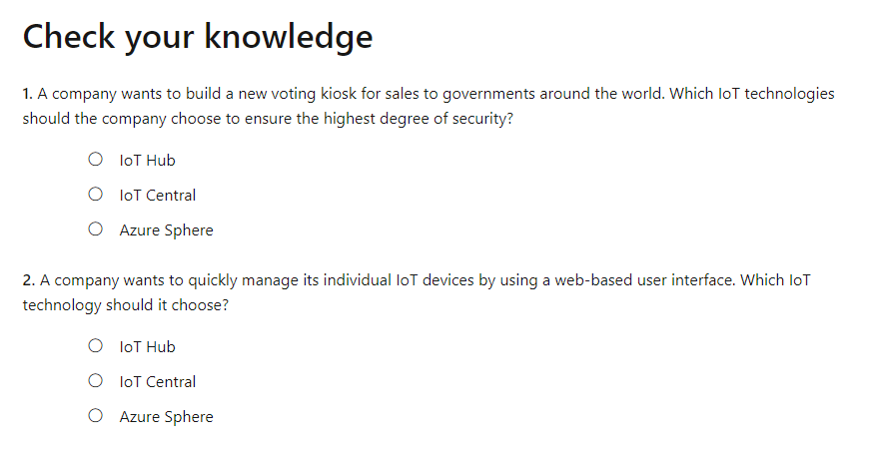
Knowledge Check
Notes:
Again, apply the decision criteria as you've been doing.
First, is it critical to ensure that the device or, in this case, each point-of-sale terminal, is not compromised? Absolutely. Device security is the primary requirement.
Next, does Tailwind Traders need a dashboard for reporting and management? Yes, the company requires a reporting and management dashboard.
So, given the responses to the decision criteria, the IoT engineering firm will build a platform on top of both Azure IoT Central and Azure Sphere. Even though no specific starter template is available in Azure IoT Central for this scenario, one can easily be adapted to accommodate the kinds of reports the company wants to see and the management operations it wants to perform.

Slide 16
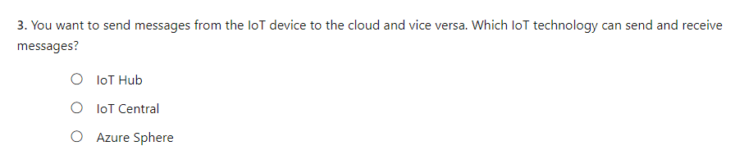
Knowledge Check
Notes:
Again, apply the decision criteria as you've been doing.
First, is it critical to ensure that the device or, in this case, each point-of-sale terminal, is not compromised? Absolutely. Device security is the primary requirement.
Next, does Tailwind Traders need a dashboard for reporting and management? Yes, the company requires a reporting and management dashboard.
So, given the responses to the decision criteria, the IoT engineering firm will build a platform on top of both Azure IoT Central and Azure Sphere. Even though no specific starter template is available in Azure IoT Central for this scenario, one can easily be adapted to accommodate the kinds of reports the company wants to see and the management operations it wants to perform.

Slide 17
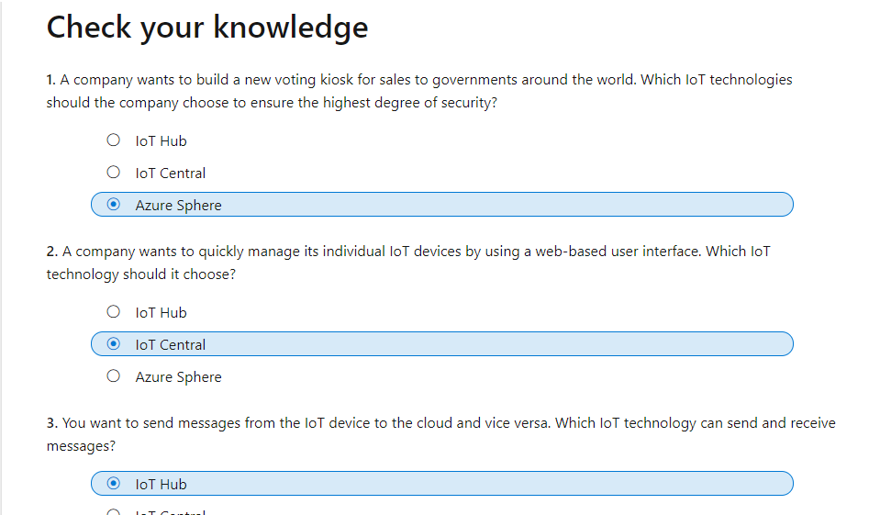
Knowledge Check
Notes:
Again, apply the decision criteria as you've been doing.
First, is it critical to ensure that the device or, in this case, each point-of-sale terminal, is not compromised? Absolutely. Device security is the primary requirement.
Next, does Tailwind Traders need a dashboard for reporting and management? Yes, the company requires a reporting and management dashboard.
So, given the responses to the decision criteria, the IoT engineering firm will build a platform on top of both Azure IoT Central and Azure Sphere. Even though no specific starter template is available in Azure IoT Central for this scenario, one can easily be adapted to accommodate the kinds of reports the company wants to see and the management operations it wants to perform.

Slide 18

Summary
This lesson has covered
What is IoT
IoT devices
Application of IoT
Choosing the right IoT service
Analyse the decision criteria
Case Study
Knowledge Check

Slide 19
Summary
Next Lesson:

